Slide 1
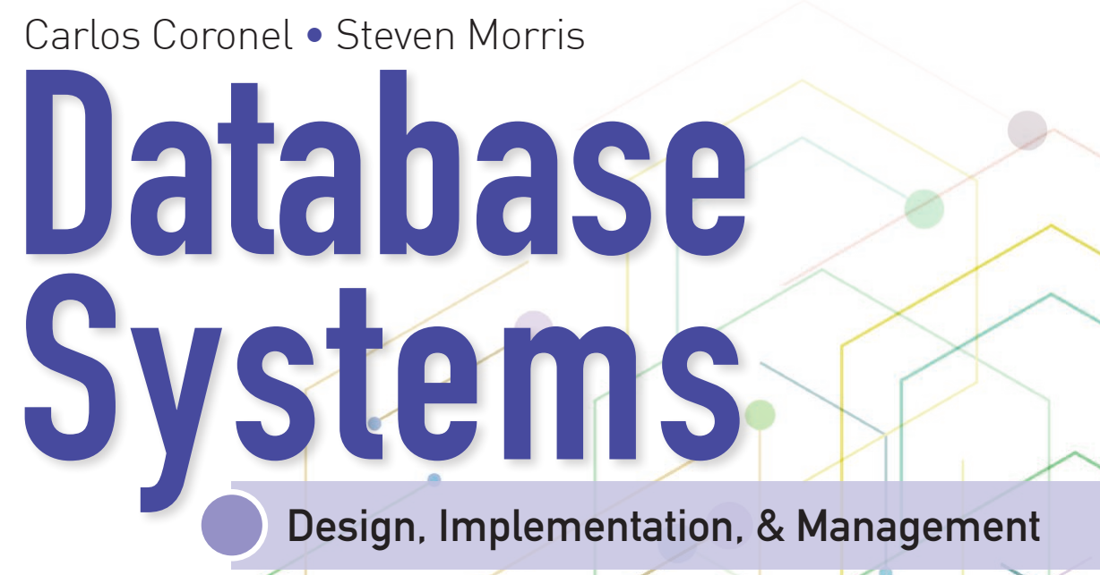
Learning Objectives
Define the difference between data and information
Describe what a database is, the various types of databases, and why they are valuable assets for decision making
Explain the importance of database design
Outline how modern databases evolved from file systems
Identify flaws in file system data management
Outline the main components of the database system
Describe the main functions of a database management system (DBMS)

Slide 2


National Economics University Faculty of Data Science & Artificial Intelligence
Database System Design, Implementation And Management Course – Entity Relationship (ER)
Modeling
Instructor: Duc Minh Vu (FDA – SLSCM Lab)
Email: minhvd [at] neu.edu.vn
12/19/2024
Database System Design, Implementation And Management
2

Slide 3
Learning Objectives
Identify the main characteristics of entity relationship components
Describe how relationships between entities are defined, refined, and incorporated into the database design process
Explain how ERD components affect database design and implementation
Describe how real-world database design often requires there conciliation of conflicting goals

Slide 4
Introduction
Good decisions require good information derived from raw facts
Data is managed most efficiently when stored in a database
Databases evolved from computer file systems
Understanding file system characteristics is important

Slide 5
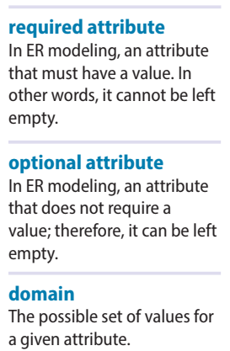
4-1 The Entity Relationship Model
4-1a Entities:
an entity actually refers to the entity set and not to a single entity occurrence.
an entity in the ERM corresponds to a table—not to a row
The ERM refers to a table row as an entity instance or entity occurrence
4-1b Attributes
Attributes are characteristics of entities.
Required and Optional Attributes
A required attribute is an attribute that must have a value
An optional attribute is an attribute that does not require a value
A domain is the set of possible values for a given attribute

Slide 6
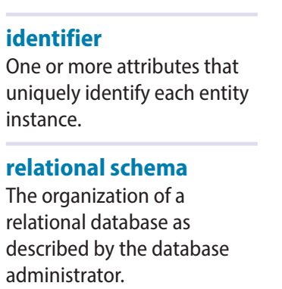
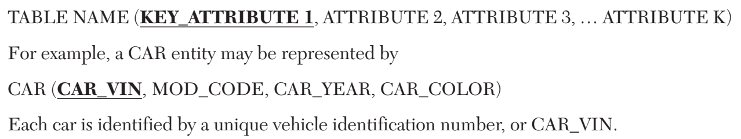
4-1 The Entity Relationship Model
4-1b Attributes
Identifiers (Primary Keys)
The ERM uses identifiers—one or more attributes that uniquely identify each entity instance.
Identifiers are underlined in the ERD
Key attributes are underlined in a frequently used shorthand notation for the table structure, called a relational schema, that uses the following format

Slide 7
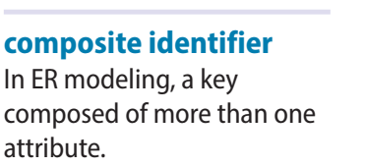
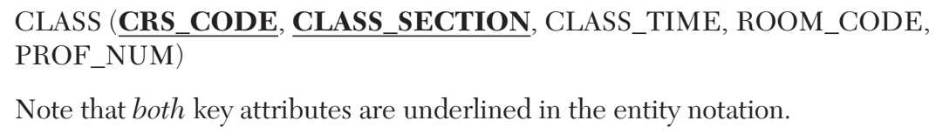
4-1 The Entity Relationship Model
4-1b Attributes
Composite Identifiers
composite identifier, a primary key composed of more than one attribute

Slide 8
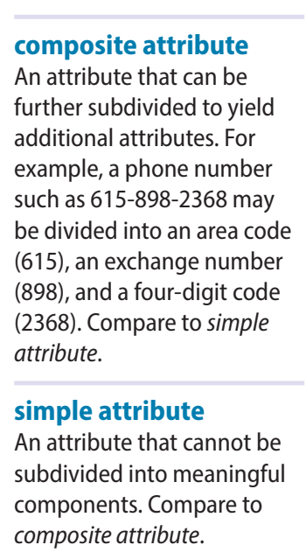
4-1 The Entity Relationship Model
4-1b Attributes
Composite and Simple Attributes
A composite attribute is an attribute that can be further subdivided to yield additional attributes.
A simple attribute is an attribute that cannot be subdivided.

Slide 9
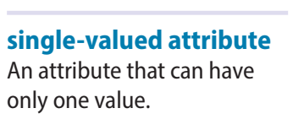
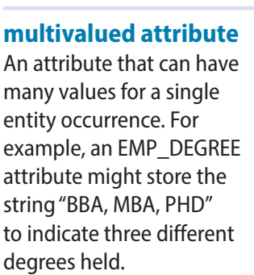
4-1 The Entity Relationship Model
4-1b Attributes
A single-valued attribute is an attribute that can have only a single value.
E.g. Social Security Number
A single-valued attribute is not necessarily a simple attribute
Multivalued attributes are attributes that can have many values.
Degrees, phone numbers

Slide 10
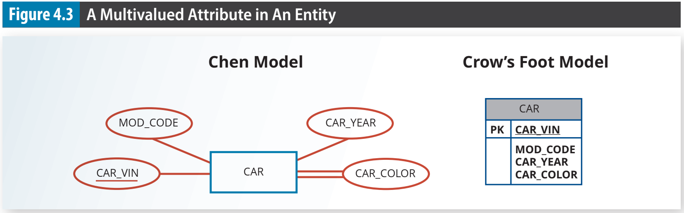

Slide 11
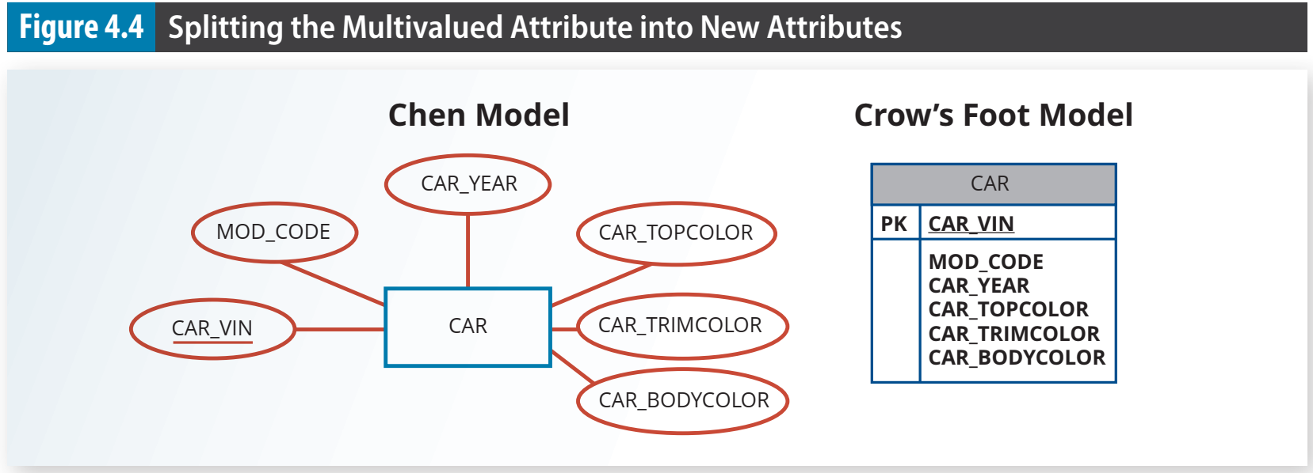

Slide 12
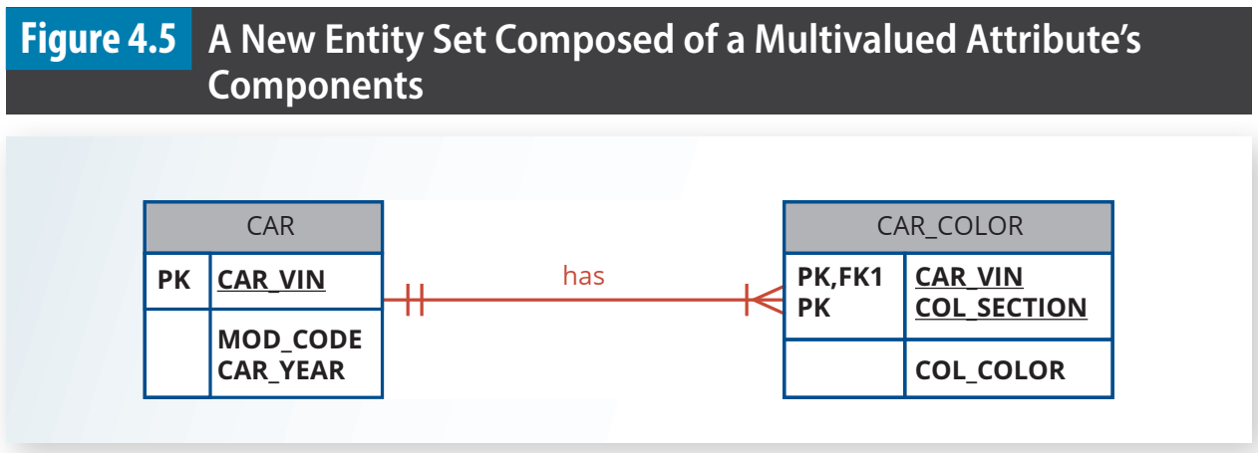

Slide 13
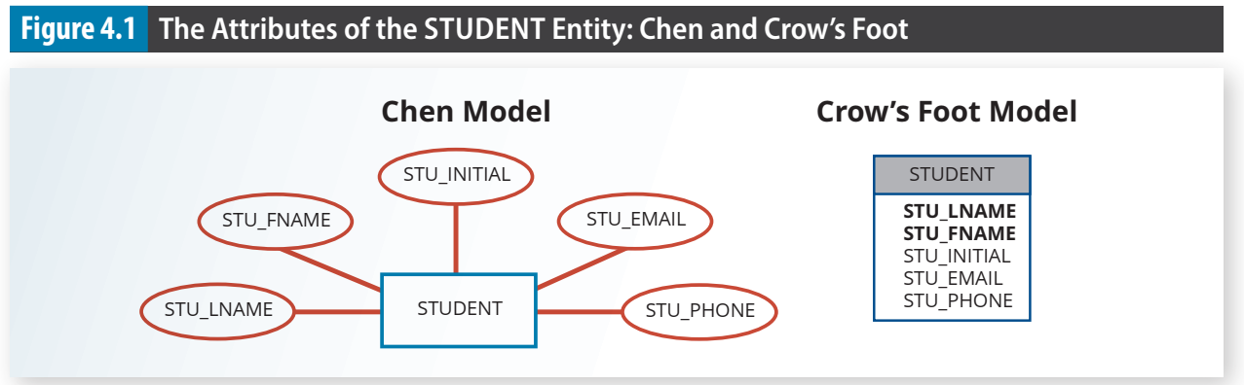

Slide 14
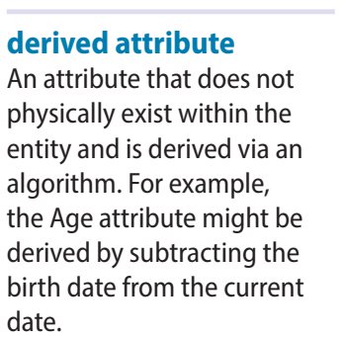
4-1 The Entity Relationship Model
4-1b Attributes
A derived attribute is an attribute whose value is calculated (derived) from other attributes.
Age = DATE() - DOB

Slide 15
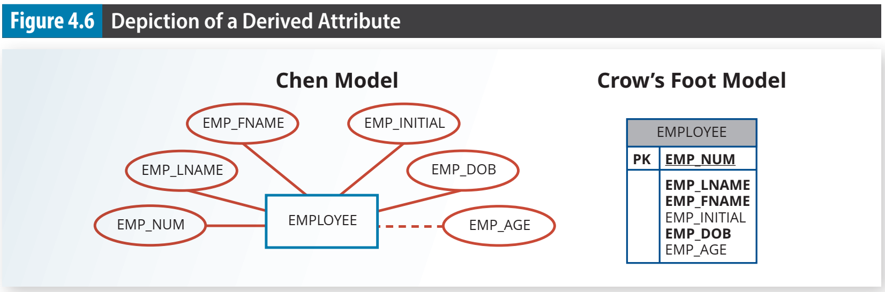

Slide 16
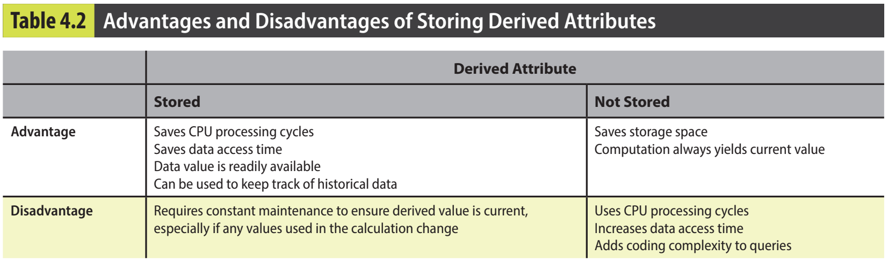

Slide 17

4-1 The Entity Relationship Model
4-1c Relationships
A relationship is an association between entities
The entities that participate in a relationship are also known as participants, and each relationship is identified by a name that describes the relationship
Relationships between entities always operate in both directions

Slide 18
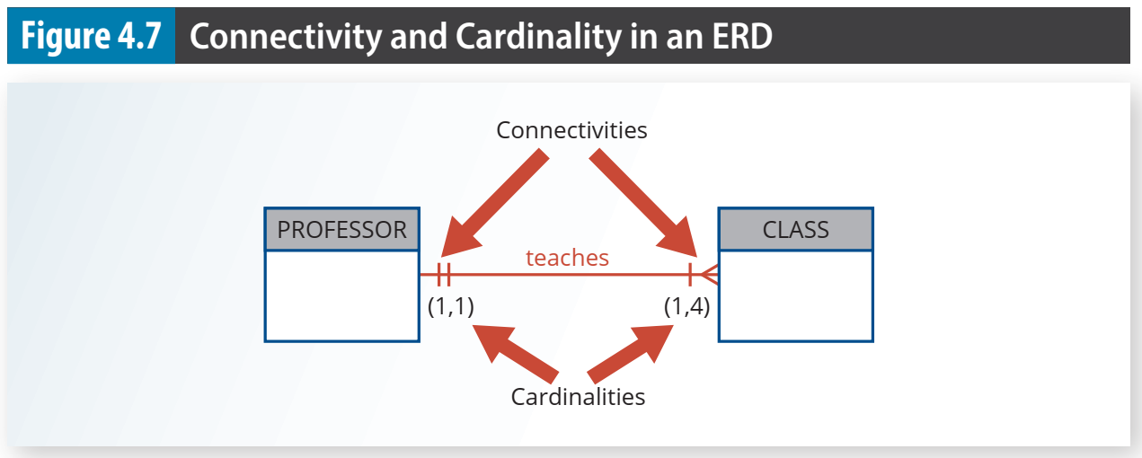
4-1 The Entity Relationship Model
4-1d Connectivity and Cardinality
Entity relationships may be classified as one-to-one, one-to-many, or many-to-many
The term connectivity is used to describe the relationship classification.
Cardinality expresses the minimum and maximum number of entity occurrences associated with one occurrence of the related entity

Slide 19
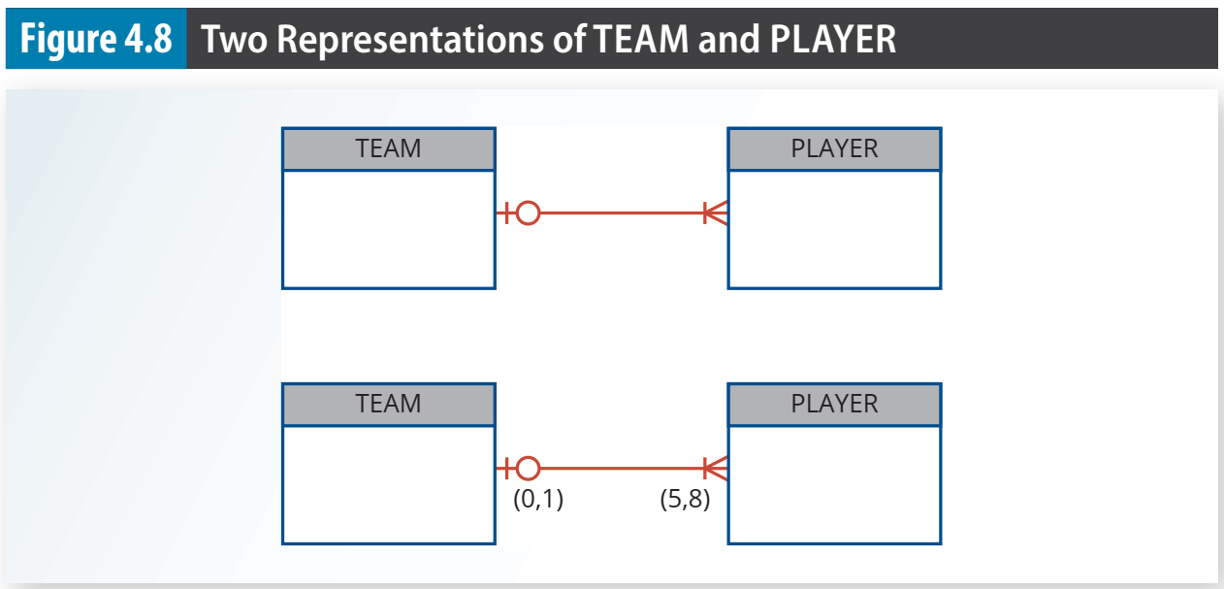

Slide 20
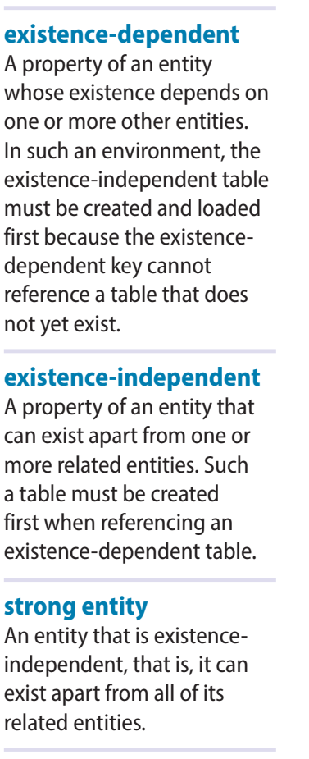
4-1 The Entity Relationship Model
4-1e Existence Dependence
An entity is said to be existence-dependent if it can exist in the database only when it is associated with another related entity occurrence.
If an entity can exist apart from all of its related entities, then it is existence-independent, and it is referred to as a strong entity or regular entity

Slide 21
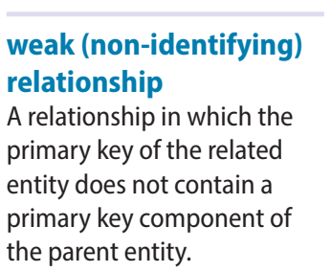
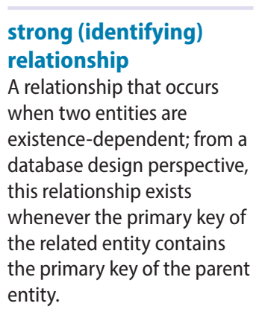
4-1 The Entity Relationship Model
4-1f Relationship Strength
A weak relationship, also known as a non-identifying relationship, exists if the primary key of the related entity does not contain a primary key component of the parent entity.
A strong (identifying) relationship exists when the primary key of the related entity contains a primary key component of the parent entity.

Slide 22
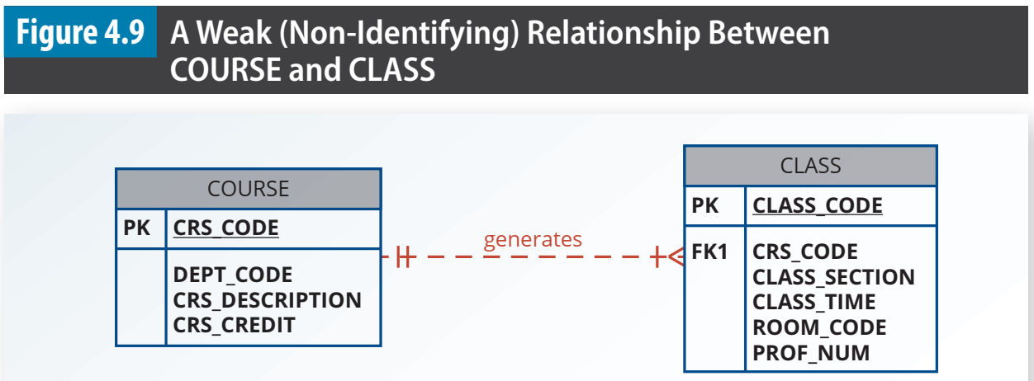

Slide 23
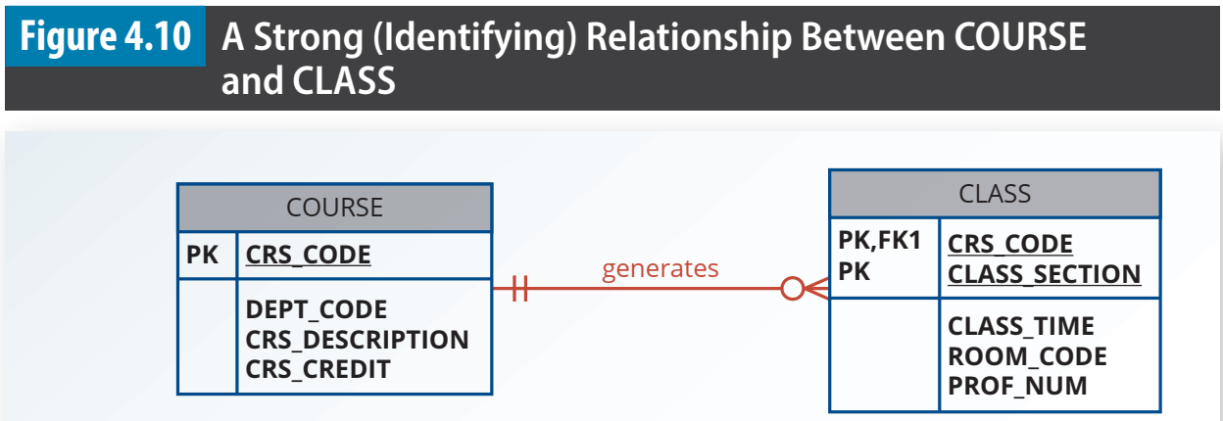

Slide 24
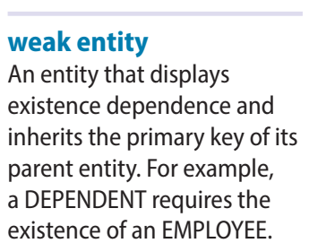
4-1 The Entity Relationship Model
4-1g Weak Entities
A weak entity is one that meets two conditions
1. The entity is existence-dependent; it cannot exist without the entity with which it has a relationship. 2. The entity has a primary key that is partially or totally derived from the parent entity in the relationship.

Slide 25
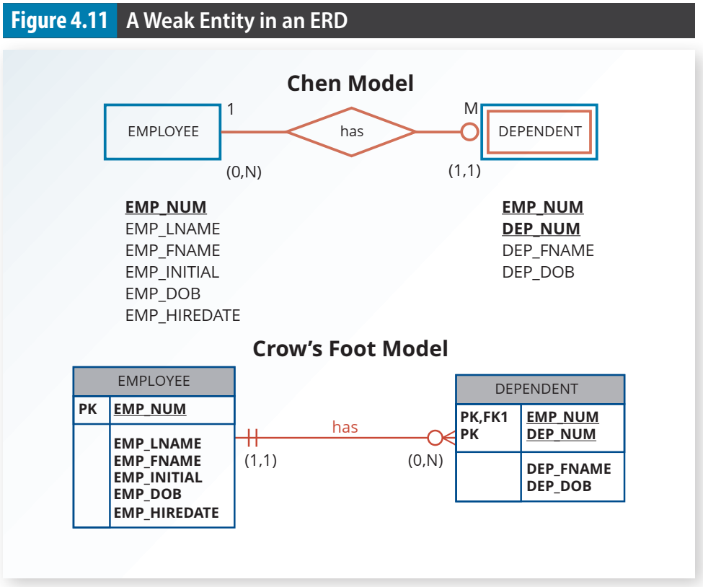

Slide 26
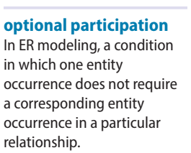
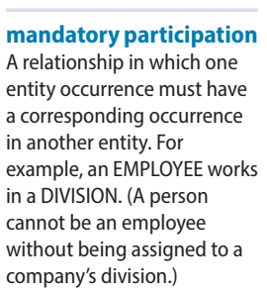
4-1 The Entity Relationship Model
4-1h Relationship Participation
Optional participation means that one entity occurrence does not require a corresponding entity occurrence in a particular relationship
COURSE vs CLASS
the CLASS entity is considered to be optional to the COURSE entity
Mandatory participation means that one entity occurrence requires a corresponding entity occurrence in a particular relationship.

Slide 27
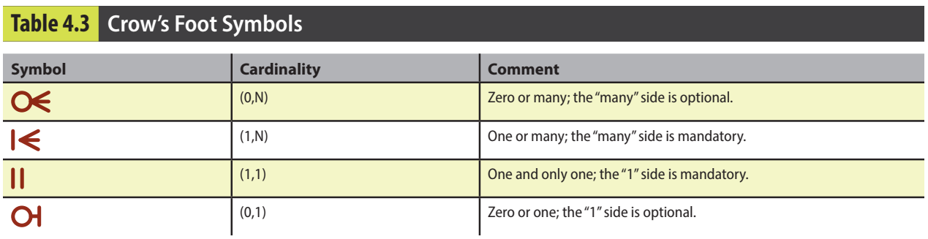

Slide 28
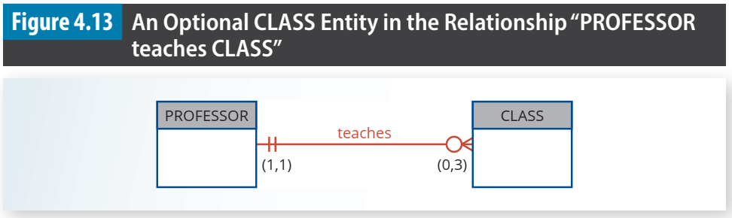

Slide 29
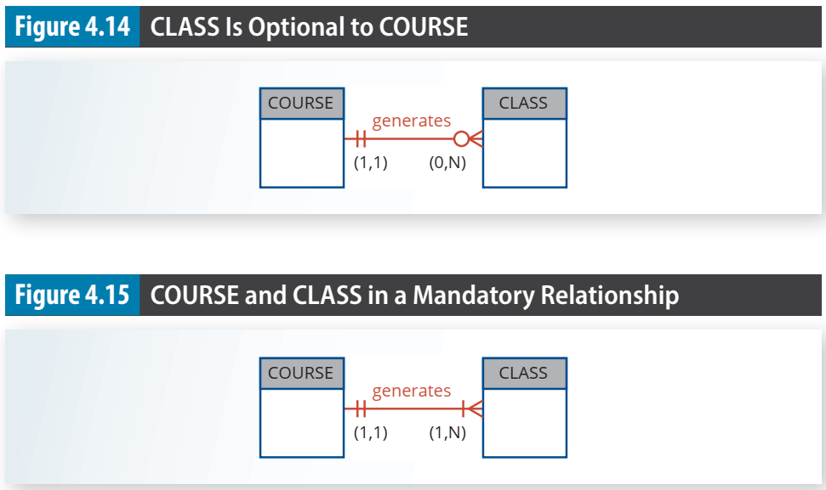

Slide 30
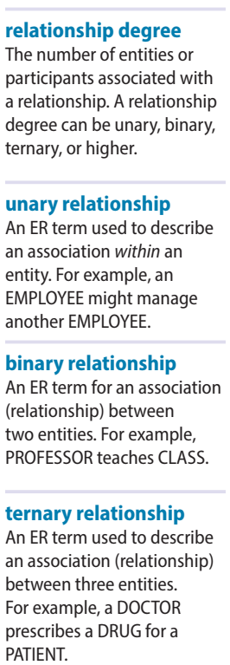
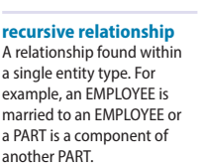
4-1 The Entity Relationship Model
4-1i Relationship Degree
A relationship degree indicates the number of entities or participants associated with a relationship.
A unary relationship exists when an association is maintained within a single entity.
A binary relationship exists when two entities are associated.
A ternary exists when three entities are associated.
Recursive relationship: an entity has a relationship with itself.

Slide 31
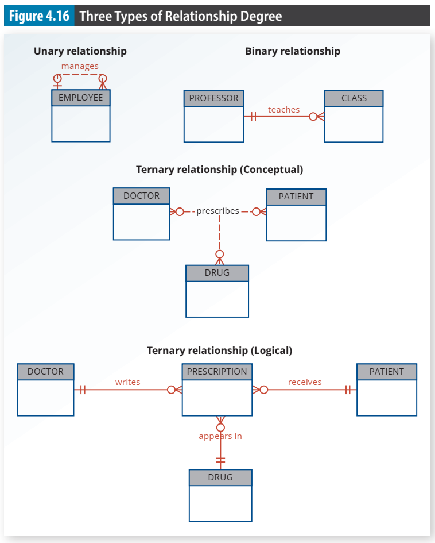

Slide 32
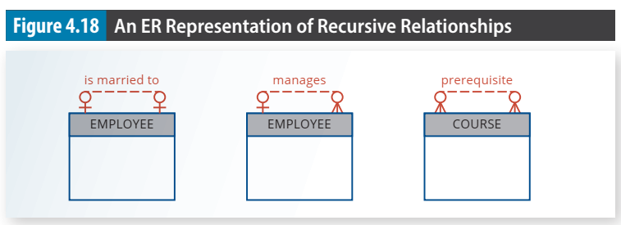

Slide 33
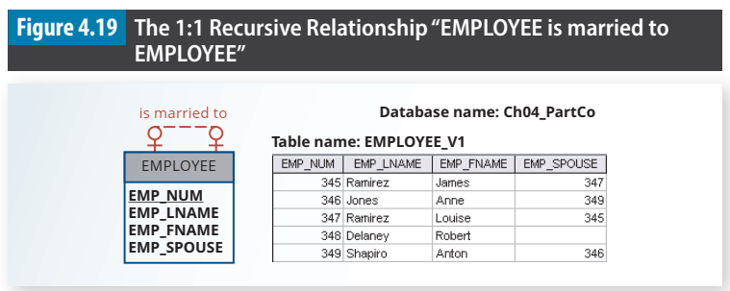

Slide 34
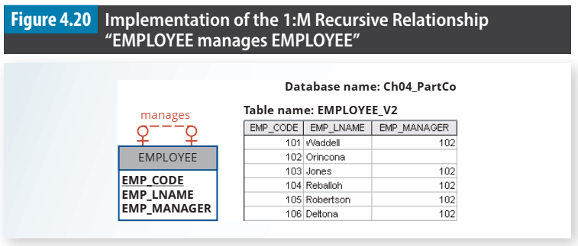

Slide 35
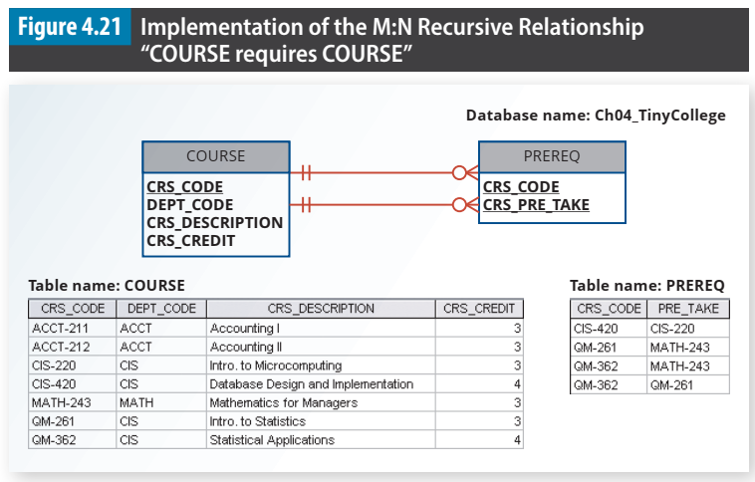
two 1:M relationships between COURSE and PREREQ
one copy of CRS_CODE was renamed to CRS_PRE_TAKE

Slide 36
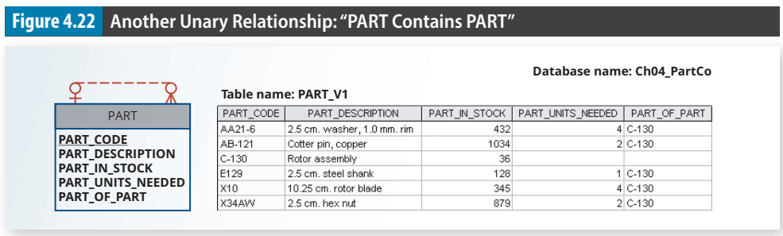

Slide 37
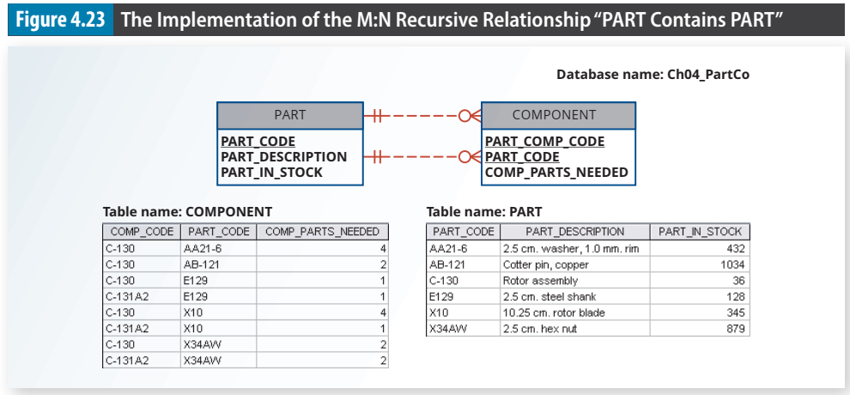

Slide 38
4-2 Developing an ER Diagram

Slide 39
4-2 Developing an ER Diagram
Create a detailed narrative of the organization’s description of operations.
Identify the business rules based on the description of operations.
Identify the main entities and relationships from the business rules.
Develop the initial ERD.
Identify the attributes and primary keys that adequately describe the entities.
Revise and review the ERD

Slide 40
Tiny College ERD
Tiny College (TC) is divided into several schools. Each school is administered by a dean who is a professor. Each professor can be the dean of only one school, and a professor is not required to be the dean of any school.
a 1:1 relationship exists between PROFESSOR and SCHOOL
Each school comprises several departments. On the other hand, each department belongs to only a single school.

Slide 41
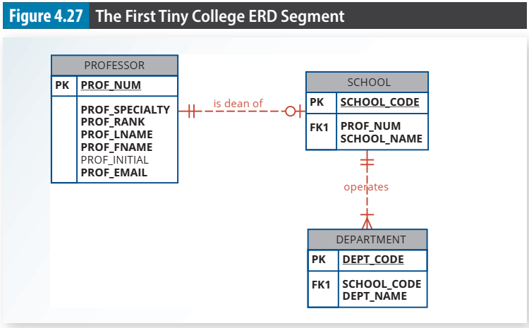

Slide 42
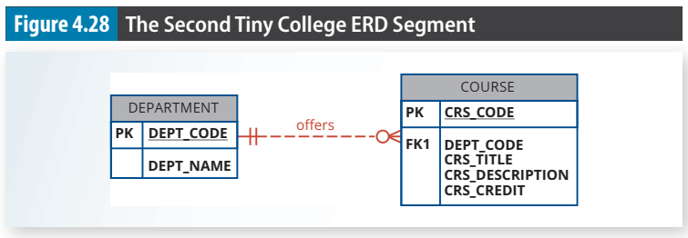
Tiny College ERD
Each department may offer courses.
Tiny College had some departments that were classified as “research only,” they would not offer courses
The COURSE entity would be optional to the DEPARTMENT entity

Slide 43
Tiny College ERD
A department may offer several sections (classes) of the same course. Each of those classes is taught by a professor at a given time in a given place.
In short, a 1:M relationship exists between COURSE and CLASS.
Each class is offered during a given semester. SEMESTER defines the year and the term that the class will be offered

Slide 44
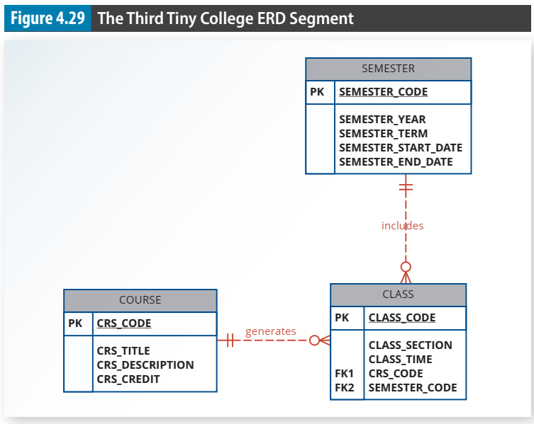

Slide 45
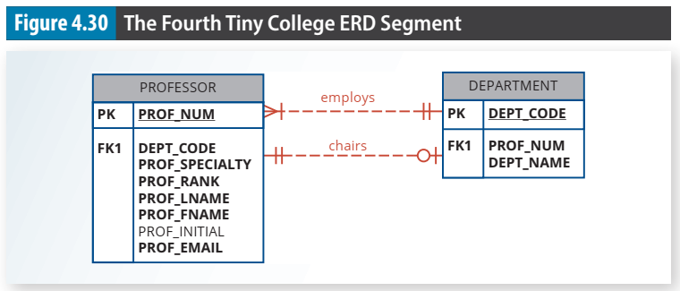
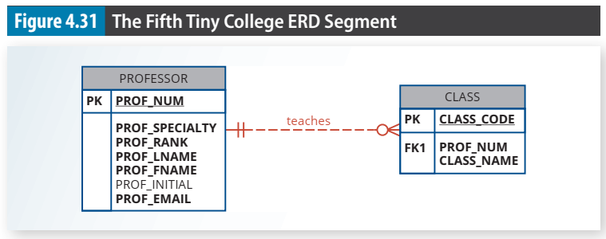
Tiny College ERD
Each department should have one or more professors assigned to it. One and only one of those professors chairs the department, and no professor is required to accept the chair position.
DEPARTMENT is optional to PROFESSOR in the “chairs” relationship.
Each professor may teach up to four classes; each class is a section of a course. A professor may also be on a research contract and teach no classes at all.

Slide 46
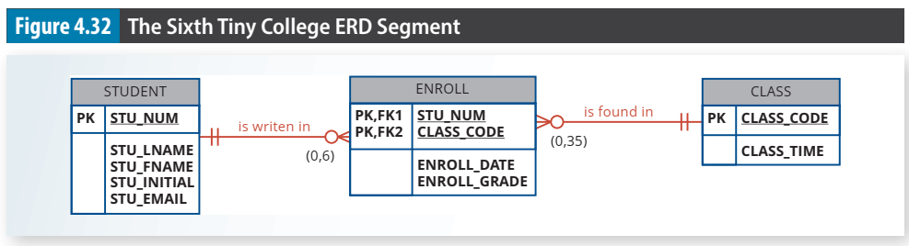
Tiny College ERD
A student may enroll in several classes but take each class only once during any given enrollment period.
Each student may enroll in up to six classes, and each class may have up to 35 students

Slide 47
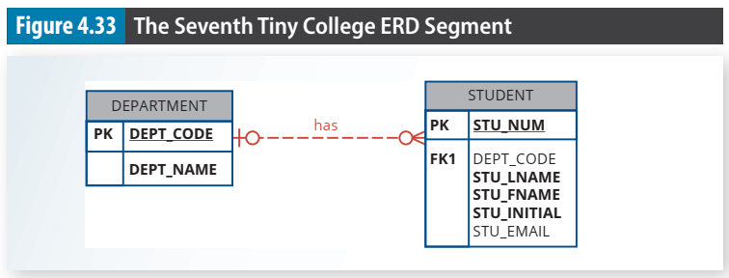
Tiny College ERD
Each department has several (or many) students whose major is offered by that department.
Each student has only a single major and is therefore associated with a single department.
it is possible for a student not to declare a major field of study

Slide 48
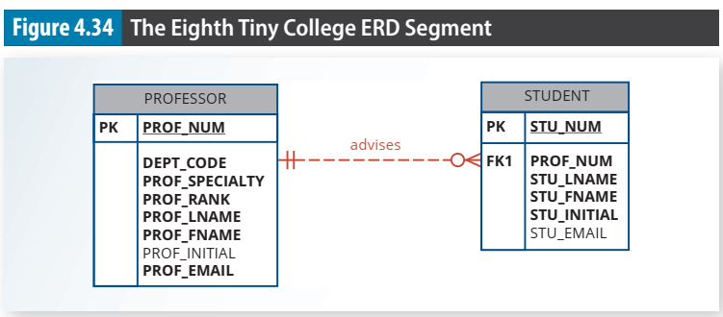
Tiny College ERD
Each student has an advisor in his or her department; each advisor counsels several students.
An advisor is also a professor, but not all professors advise students.

Slide 49
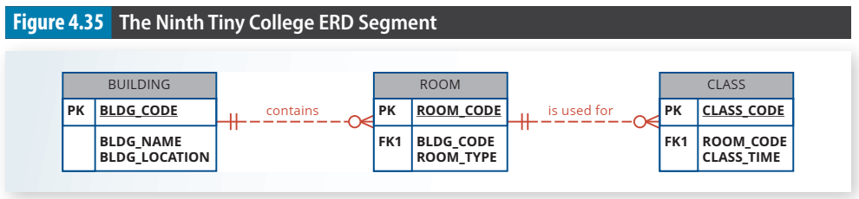
Tiny College ERD
A BUILDING can contain many ROOMs, but each ROOM is found in a single BUILDING.
Some buildings do not contain (class) rooms. For example, a storage building might not contain any named rooms at all.

Slide 50
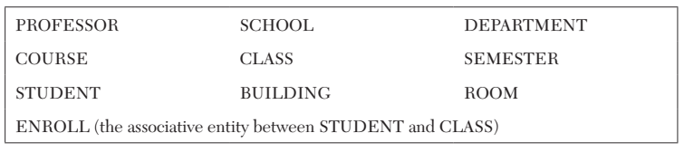

Slide 51
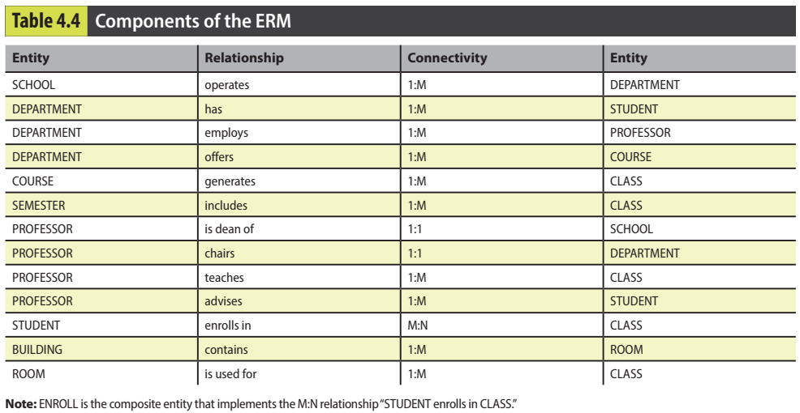

Slide 52


Slide 53


Slide 54
4-3 Database Design Challenges: Conflicting Goals

Slide 55
4-3 Database Design Challenges: Conflicting Goals
Conflicting goals: design standards (design elegance), processing speed, and information requirements.
Design standards: conform to design standards. Design standards govern the presentation of all components within the database design.
Minimize data redundancies, minimizing the likelihood that destructive data anomalies will occur. Avoid nulls to the greatest extent possible. ...
Processing speed. Minimal access time, which may be achieved by minimizing the number and complexity of logically desirable relationships.
For example, a “perfect” design might use a 1:1 relationship to avoid nulls, while a design that emphasizes higher transaction speed might combine the two tables to avoid the use of an additional relationship, using dummy entries to avoid the nulls. also be forced to include derived attributes in the design.

Slide 56
4-3 Database Design Challenges: Conflicting Goals
Conflicting goals: design standards (design elegance), processing speed, and information requirements.
Information requirements: Complex information requirements may dictate data transformations, and they may expand the number of entities and attributes within the design. Database may have to sacrifice some of its “clean” design structures and high transaction speed to ensure maximum information generation.
A detailed sales report must be generated periodically. The sales report includes all invoice subtotals, taxes, and totals; even the invoice lines include subtotals.
The sales report includes hundreds of thousands (or even millions) of invoices, computing the totals, taxes, and subtotals is likely to take some time.
If those computations had been made and stored as derived attributes in the INVOICE and LINE tables at the time of the transaction, the real-time transaction speed might have declined

Slide 57


